Slide 1

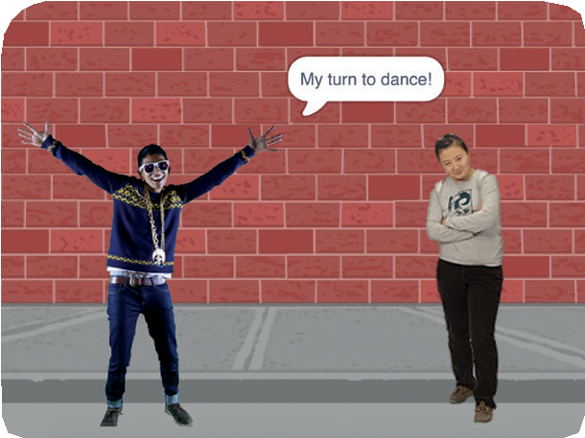
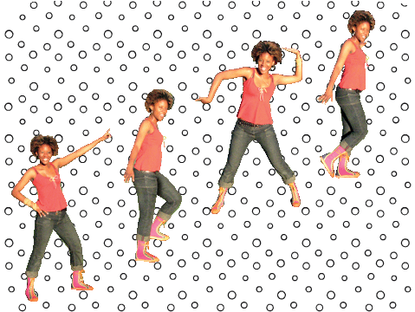
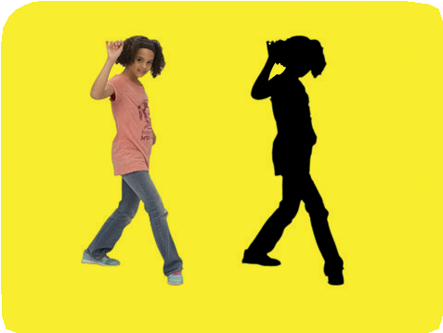
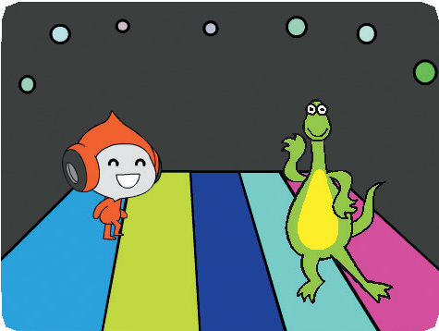


Let’s Dance Cards
Design an animated dance scene with music and dance moves.
yyyymmdd
scratch.mit.edu
Set of 9

Slide 2
Let’s Dance Cards
Try these cards in any order:
Dance Sequence
Dance Loop
Play Music
Take Turns
Starting Position
Shadow Effect
Interactive Dance
Color Effect
Leave a Trail
scratch.mit.edu
Set of 9 cards

Slide 3




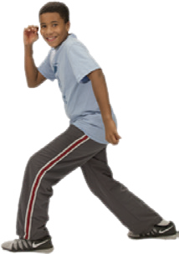
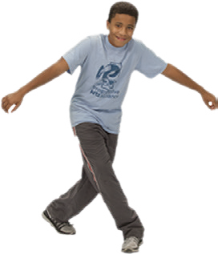

Dance Sequence
Make an animated dance.
yyyymmdd
Let’s Dance
1
Dance Party!

Slide 4


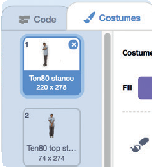




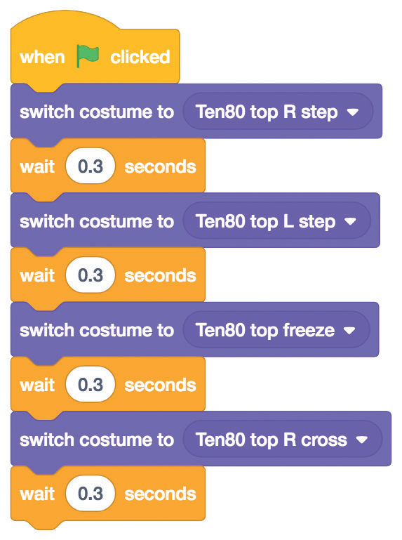

Dance Sequence
scratch.mit.edu
GET READY
Click the Costumes tab to see the different dance moves.
Choose a dancer.
Ten80 Dance
To see just the dance sprites, click the Dance category at the top of the Sprite Library.
ADD THIS CODE
Click the Code tab.
Ten80 Dance
Type how long to wait
between dance moves.
Pick different dance moves.
TRY IT
Click the green flag to start.

Slide 5




Dance Loop
Repeat a series of dance steps.
yyyymmdd
Let’s Dance
2
Dance Party!

Slide 6


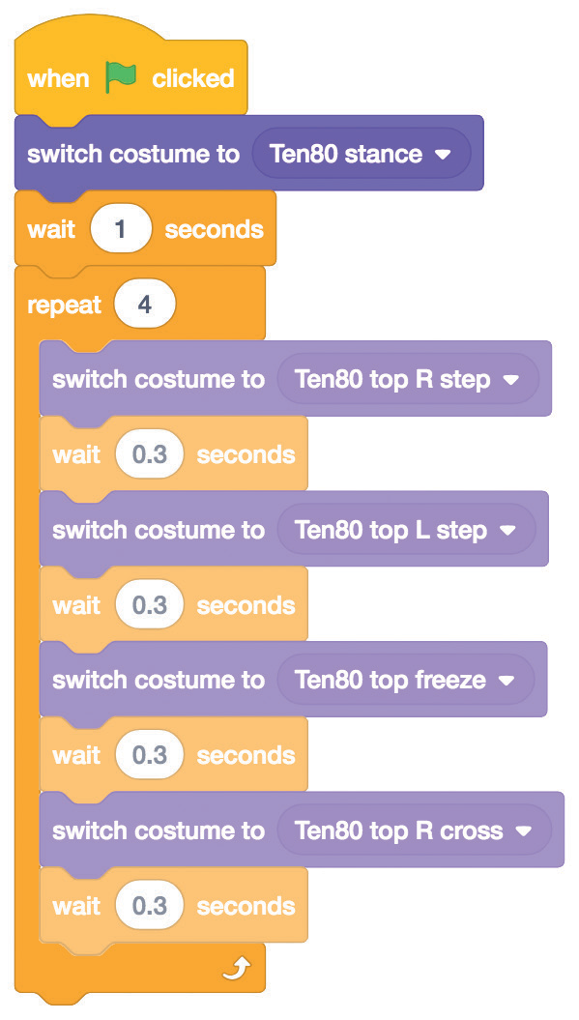

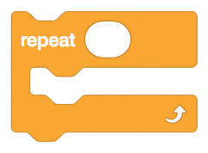

Dance Loop
scratch.mit.edu
GET READY
Go to the Sprite Library.
Ten80 Dance
Click the Dance category.
Choose a dancer.
ADD THIS CODE
Choose a dance pose.
Ten80 Dance
Type how many times you want to repeat the dance.
Add a repeat block around your dance sequence.
TRY IT
Click the green flag to start.

Slide 7
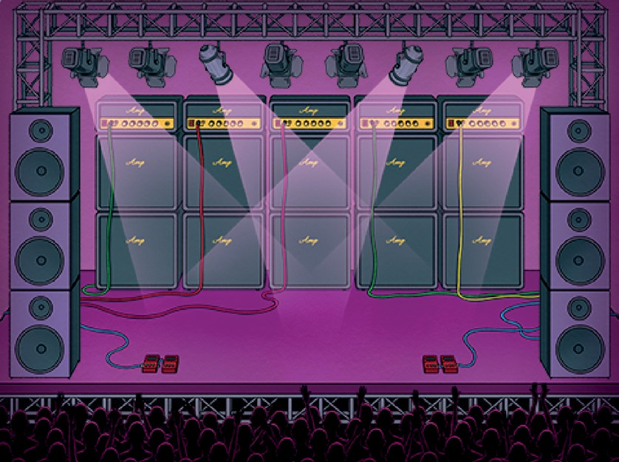
Play Music
Play and loop a song.
yyyymmdd
Let’s Dance
3

Slide 8


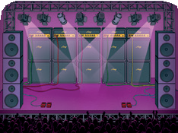


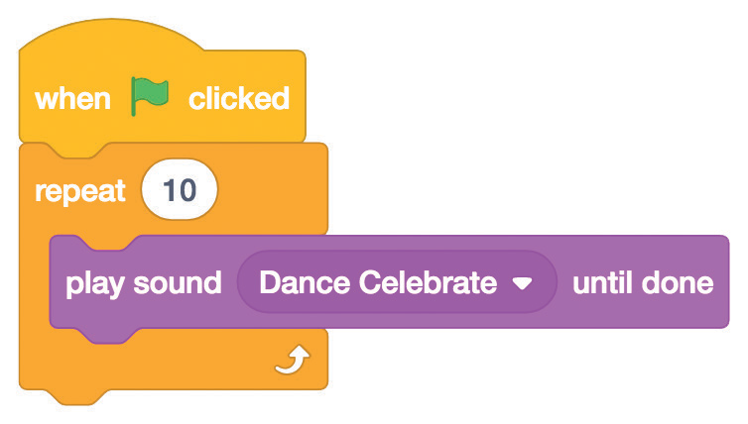



Play Music
scratch.mit.edu
GET READY
Click the Sounds tab.
Choose a backdrop.
Concert
Choose a song from the
Loops category.
ADD THIS CODE
Click the Code tab.
Type how many times you want the song to repeat.
Concert
TIP
(not
Make sure to use
or else the music won’t finish playing before it begins again.
)

Slide 9
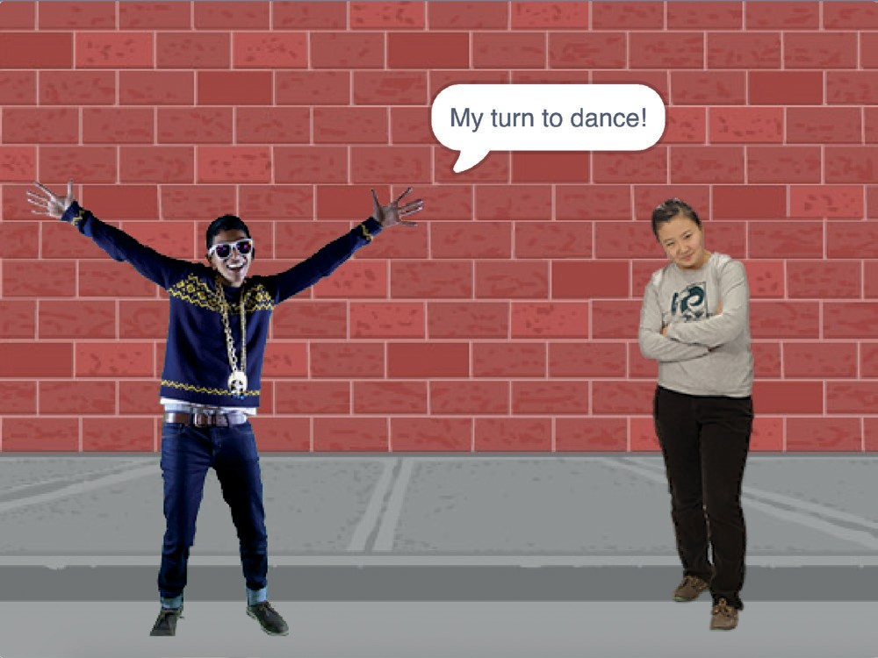
Take Turns
Coordinate dancers so that one begins after the other finishes.
yyyymmdd
Let’s Dance
4

Slide 10



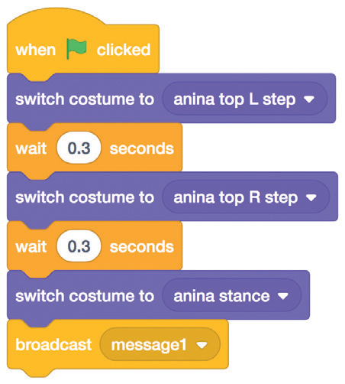

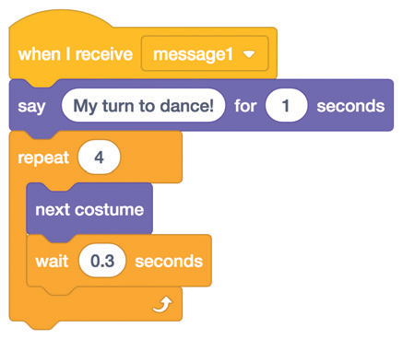

Take Turns
scratch.mit.edu
GET READY
Choose two dancers from the Dance category.
Anina Dance
Champ99
ADD THIS CODE
Anina Dance
Broadcast a message.
Tell this dancer sprite what to do when it receives the message.
Champ99
TRY IT
Click the green flag to start.

Slide 11
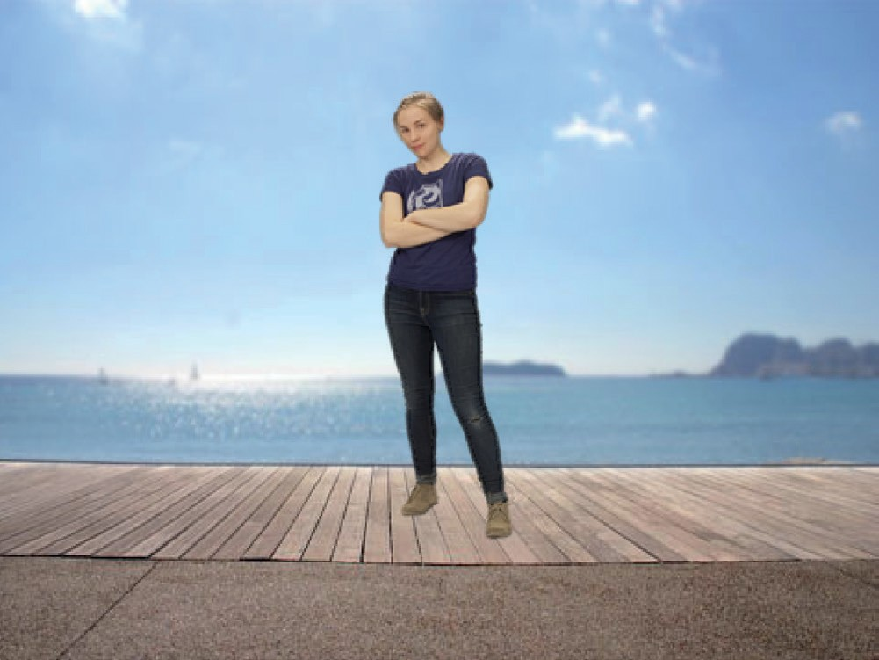
Starting Position
Tell your dancers where to start.
yyyymmdd
Let’s Dance
5

Slide 12



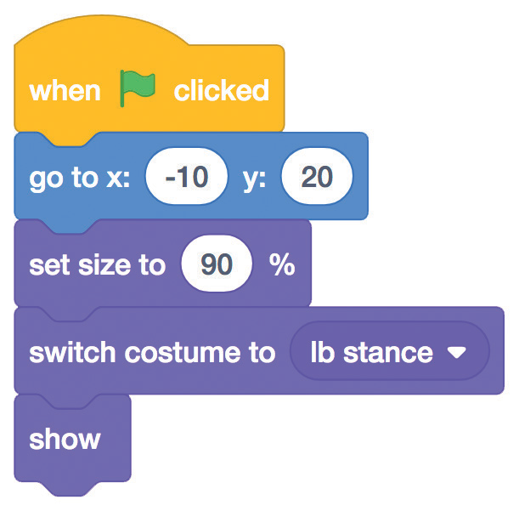





Starting Position
scratch.mit.edu
GET READY
Go to the Sprite Library.
LB Dance
Click the Dance category.
Choose a dancer.
ADD THIS CODE
LB Dance
Tell your sprite where to start.
Set the sprite’s size.
Choose a starting costume.
Make sure the sprite is showing.
TIP
Use to set a sprite’s position on the Stage.
x is the position on the Stage from left to right.
y is the position on the Stage from top to bottom.

Slide 13
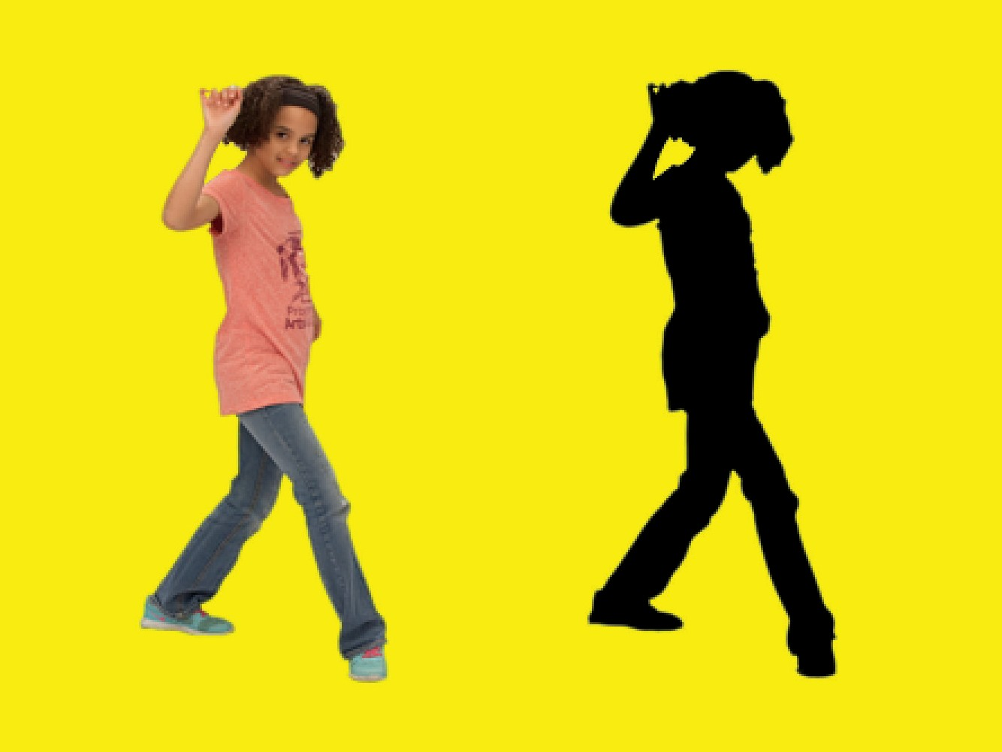
Shadow Effect
Make a dancing silhouette.
yyyymmdd
Let’s Dance
6

Slide 14


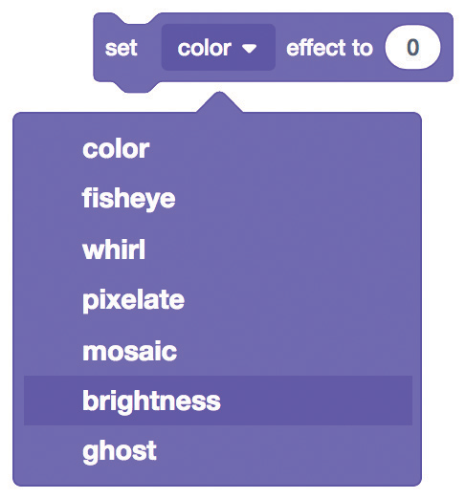
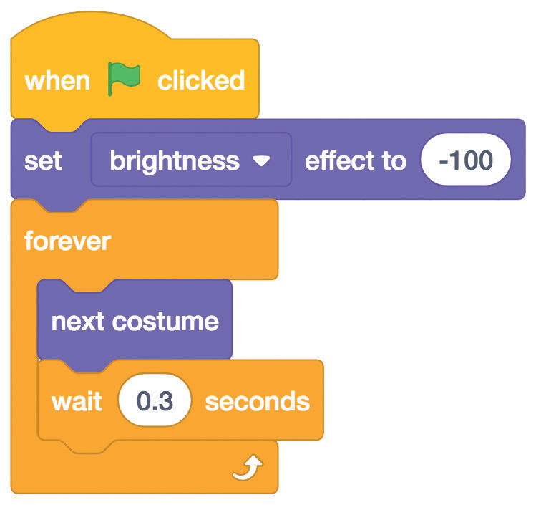

Shadow Effect
scratch.mit.edu
GET READY
Go to the Sprite Library.
Click the Dance category.
Jouvi Dance
Choose a dancer.
ADD THIS CODE
Choose brightness
from the menu.
Set the brightness to -100 to make the sprite completely dark.
TRY IT
Click the green flag to start.
Click the stop sign to stop.

Slide 15



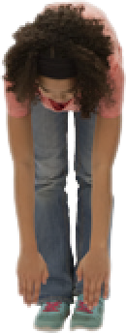
Interactive Dance
Press keys to switch dance moves.
yyyymmdd
Let’s Dance
7

Slide 16

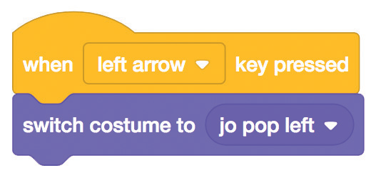
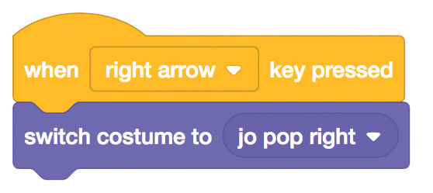
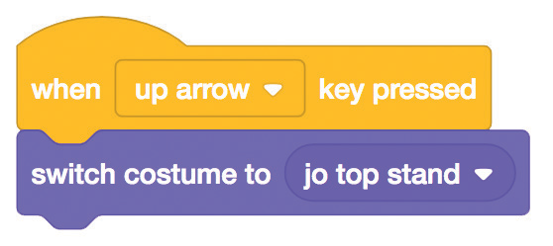
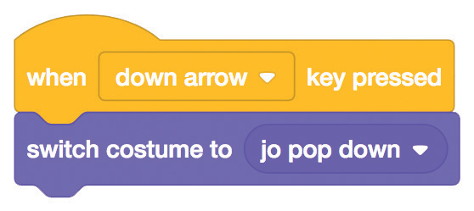




Interactive Dance
scratch.mit.edu
GET READY
Go to the Sprite Library.
Click the Dance category
Jouvi Dance
Choose a dancer.
ADD THIS CODE
Choose a different key to press for each dance move.
Pick a dance move from the menu.
TRY IT
Press the arrow keys on your keyboard.

Slide 17
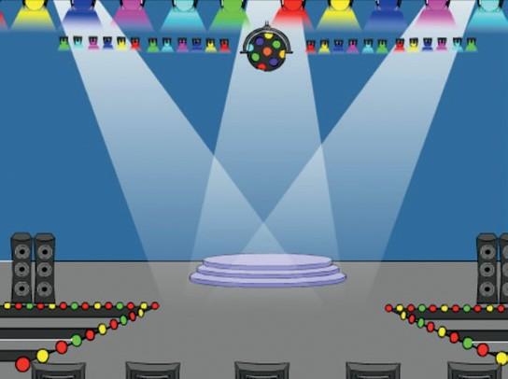
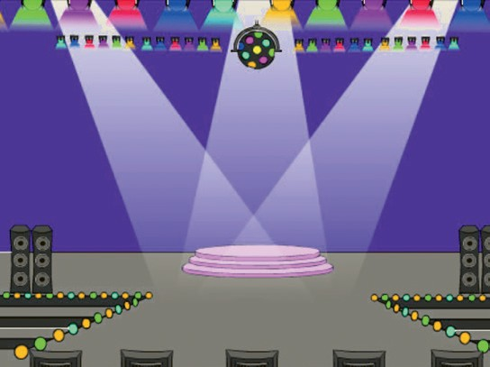
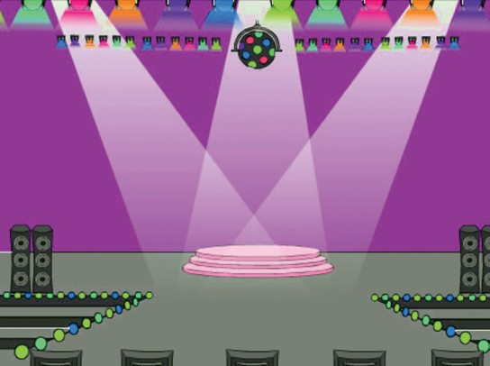
Color Effect
Make the backdrop change colors.
yyyymmdd
Let’s Dance
8

Slide 18
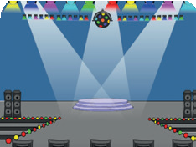
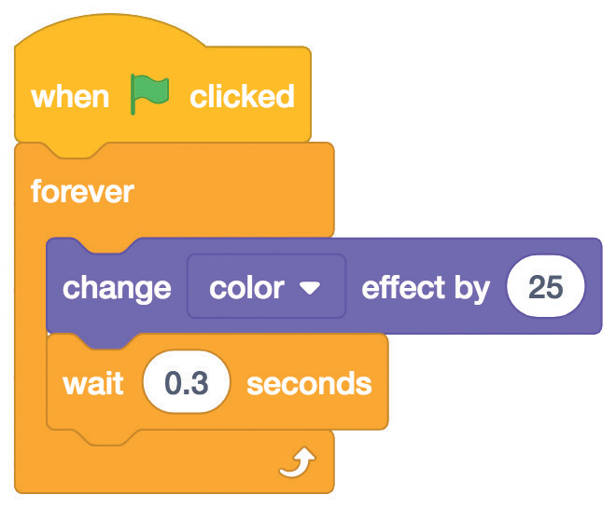


Color Effect
scratch.mit.edu
GET READY
Choose a backdrop.
Spotlight
ADD THIS CODE
Spotlight
Try different numbers.
TRY IT
Click the green flag to start.

Slide 19
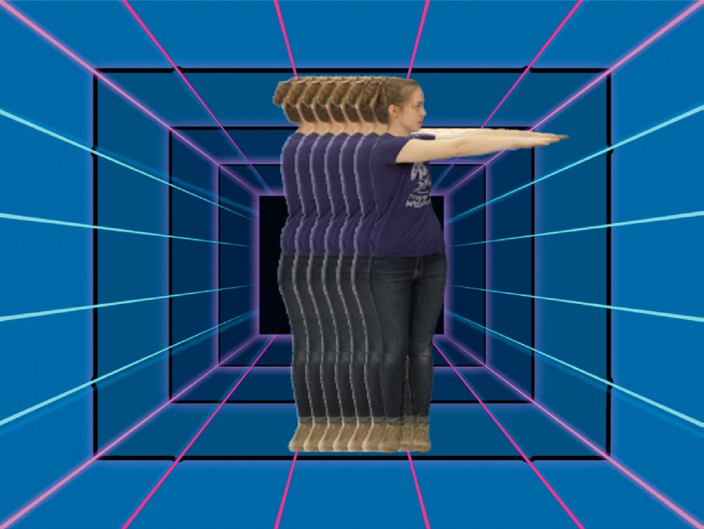
Leave a Trail
Stamp a trail as your dancer moves.
yyyymmdd
Let’s Dance
9
Dance Party!

Slide 20


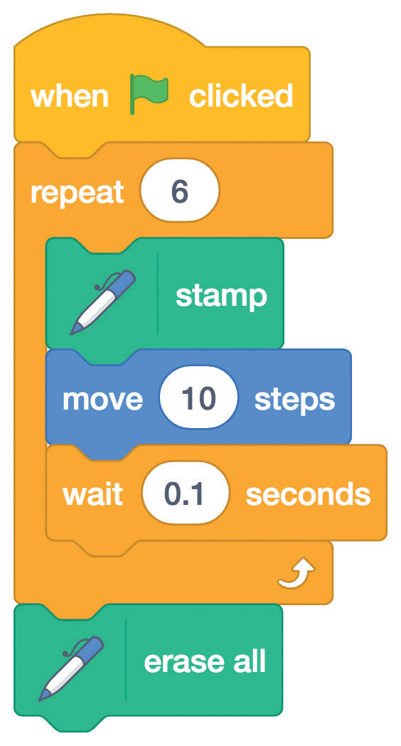

Leave a Trail
scratch.mit.edu
GET READY
Choose a dancer from the Dance category.
LB Dance
Click the Extensions button, and then click Pen to add the blocks.
ADD THIS CODE
LB Dance
Type how many times to repeat.
Stamp an image of the sprite on the Stage.
Clear all the stamps.
TRY IT
Click the green flag to start.

